Slide 1


Construction and Evaluation of
the HEV Control Algorithm using
a Black-Box simulator
❇︎Nariaki Tateiwa¹, Nozomi Hata¹, Akira Tanaka¹, Takashi Nakayama¹,
Akihiro Yoshida¹, Takashi Wakamatsu¹, Katsuki Fujisawa²
¹Graduate School of Mathematics, Kyushu University, Fukuoka, Japan
²Institute of Mathematics for Industry, Kyushu University, Fukuoka, Japan
& AIST-Tokyo Tech Real World Big-Data Computation Open Innovation Laboratory, Tokyo, Japan
2019/3/28
The 4th IMI-ISM-ZIB MODAL Workshop Mathematical Optimization and Data Analysis
@ The Institute of Statistical Mathematics, Tokyo, Japan
Notes:
Thank you for introduction and give me a opportunity to take a presentation today.
My name is Nariaki Tateiwa and I‘m a graduate student at Kyushu University in Japan.
The subject of my presentation is Construction and Evaluation of the HEV Control Algorithm using a Black-Box simulator.
Today, I’d like to talk about the way to optimize hybrid electric vehicle control.
This is a collaborative research with Toyota Motor Corporation.

Slide 2
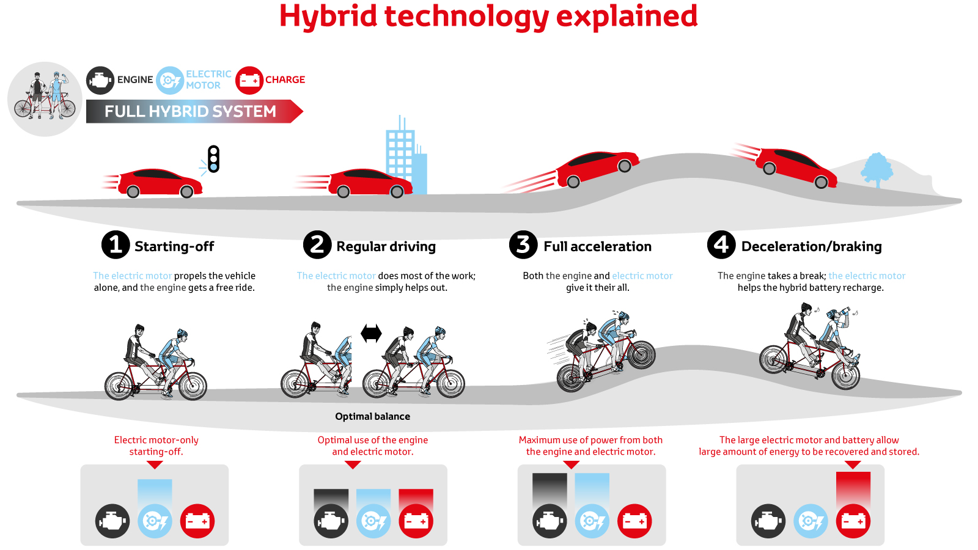
HEV Technology Explained
EV driving mode is driving with only motors
HV driving mode is driving with engine and motors
https://www.toyota-europe.com/world-of-toyota/feel/environment/better-air/hybrid-vehicle/howHybridworks
Notes:
HEV has an engine and motors as a power source.
HEV has 2 driving mode,
We call EV driving mode driving …
By changing the output ratio of the engine and motors and switching HV and EV driving mode according the situation like this figure, HEV can drive more efficient than the car with only engine.

Slide 3
Outline
Background and Problem Setting
Our Proposed Algorithm
  Local Optimization (Optimize in a part of Driving Cycle)
  Global Optimization (Optimize in a whole of Driving Cycle)
  Reduce Calculation Time
Numerical Experiments
Notes:
Here is the outline of my presentation.
First, I talk about
Nest, I explain
Finally, I show the result of Numerical experiments

Slide 4
Outline
Background and Problem Setting
Our Proposed Algorithm
  Local Optimization (Optimize in a part of Driving Cycle)
  Global Optimization (Optimize in a whole of Driving Cycle)
  Reduce Calculation Time
Numerical Experiments
Notes:
Here is the outline of my presentation.
First, I talk about
Nest, I explain
Finally, I show the result of Numerical experiments

Slide 5

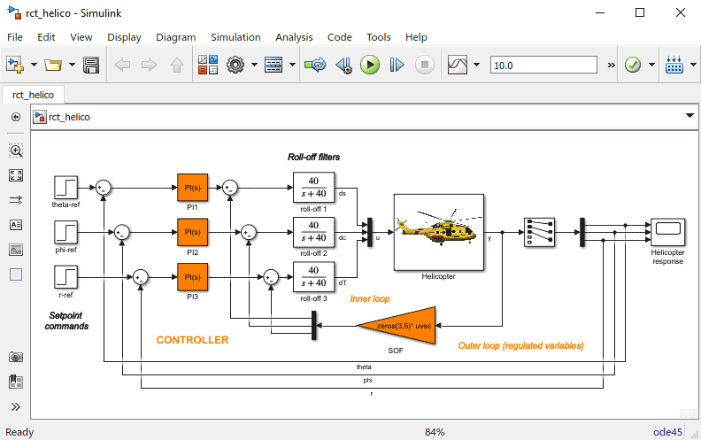


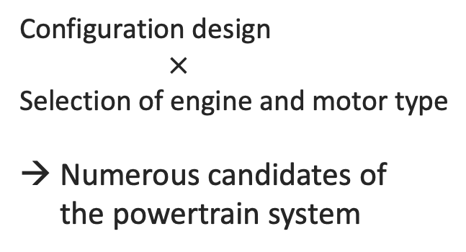
Model Based Development
Powertrain of
Developing vehicle
Powertrain
Simulator
modeling
evaluating
Configuration design
$×$
Selection of engine and motor type
Numerous candidates of
the powertrain system
best!
Notes:
The model based development is a mainstream in the field of the development of new vehicles.
In model based development, we model a powertrain of vehicle and generate a powertrain-simulator, and evaluate the performance of the simulator instead of the original powertrain.
In the development stage, the developers should consider the numerous candidates of the configuration of the powertrain due to the based configuration design and selection of engine and motor.
and they have to find the best configuration of the powertrain from these.
Therefore, it is important to evaluate each candidate of the configuration fast and at low cost.
Next, I explain how to evaluate the performance of powertrain simulator.

Slide 6
How to Evaluate the Simulator?
Measure the fuel consumption when
the vehicle virtually travels on the computer by using the simulator
Drive to follow the target velocity of Driving Cycle
Simulator
Target Engine Torque
Target Motor Torque
input
output
State of vehicle
WLTC Driving Cycle (30 minute)
Notes:
When we evaluate the performance of the simulator,
we measure the fuel …
the lower figure shows the WLTC Driving Cycle, and this is the vehicle speed pattern about 30 minute, and this is world standard driving cycle.
To control the vehicle using simulator, we input the target engine torque and motor torque.
The greater we input engine torque, the greater engine shaft speed is.

Slide 7

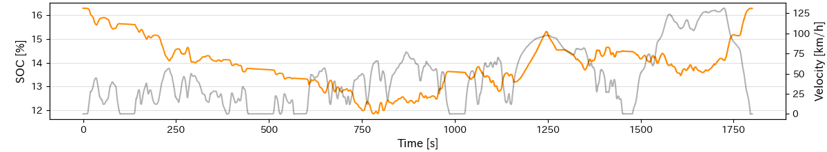
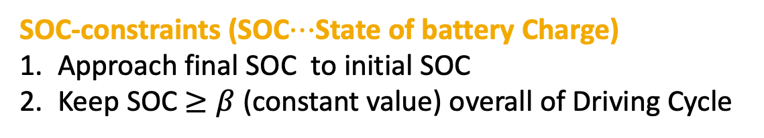

How to Evaluate the HEV Simulator?
Measure the fuel consumption when
the vehicle virtually travels on the computer by using the simulator
Drive to follow the target velocity of Driving Cycle
SOC-constraints (SOC$⋯$State of battery Charge)
Approach final SOC to initial SOC
Keep SOC $≥β$ (constant value) overall of Driving Cycle
initial SOC
16 %
final SOC
16 %
Transition of SOC
$$β$$
Notes:
In the case of HEV simulator, we should add two other SOC constraints.
SOC means the battery remaining quantity.
First constraint is we should …, for example if we start to drive with 16% SOC, we should end to drive with 16% SOC.
Another is that we should always keep SOC is greater than or equal a constant value $β$ for the sake of the electric equipment of vehicle.

Slide 8
How to Evaluate the HEV Simulator?
Important points to drive the Driving Cycle efficiently
When should we operate the engine in Driving Cycle?
Engine Torque
HV
HV
EV
EV
SOC
Notes:
There are 2 important points to drive the Driving Cycle efficiency are
When…
EV driving mode is driving only motor, and HV driving mode is driving with a engine and motors.
Basically, in the HV driving mode, vehicle charge the buttery, and in the EV driving mode vehicle use the buttery, so we hove to combine the HV and EV driving mode well to satisfy the SOC-constraints.

Slide 9
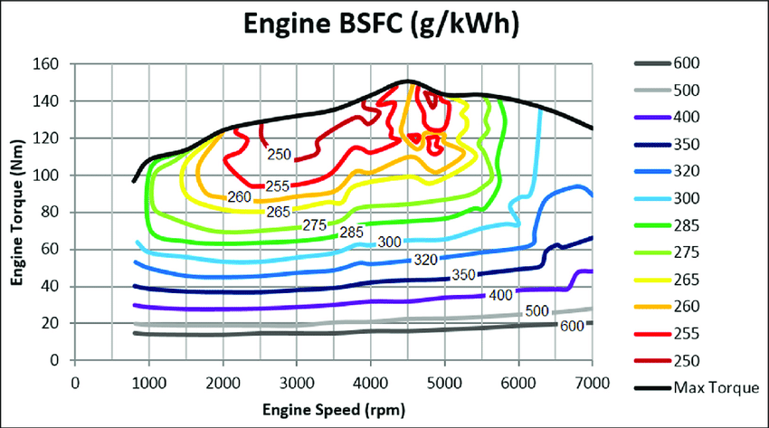
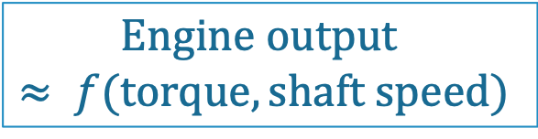
How to Evaluate the HEV Simulator?
Important points to drive the Driving Cycle efficiently
When should we operate the engine in Driving Cycle?
Where should we set the engine operating point?
sweet spot
Fuel Consumption Map [g/kWh]
$$Engine output$$
$$≈ f(torque, shaft speed)$$
Engine Torque [Nm]
Engine Shaft Speed [rpm]
Notes:
The engine output and fuel consumption are mainly determined by the engine torque and the engine shaft speed.
This figure is the example of the fuel consumption map. The lower the value, the more the engine work efficiency.
The lowest value area of map is the optimal operating points of the engine, and we call this sweet spot. However the engine output at the sweet spot is much higher than the energy which is needed during normal traveling, so it is difficult to operate always the engine at the sweet spot.

Slide 10
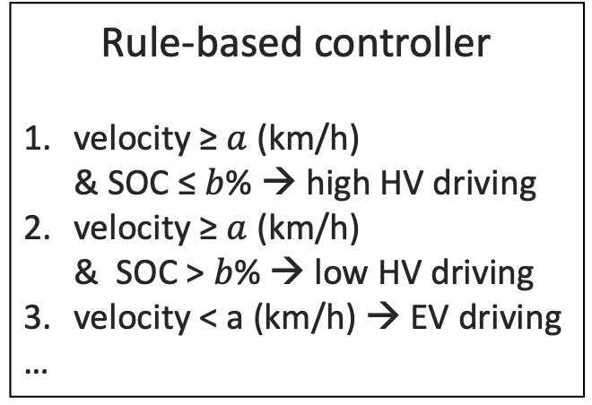
Previous Work to Evaluate the Simulator
Setting the Rule-based
controller
Chose a configuration
of the powertrain
Parameter Tuning
Drive by optimized
controller
Candidates
Simulator
Regard a simulator as a black box
for flexibility in the configuration
Rule-based controller
velocity ≥ $a$ (km/h)
& SOC ≤ $b$% → high HV driving
velocity ≥ $a$ (km/h)
& SOC > $b$% → low HV driving
velocity < a (km/h) → EV driving
…
parameter
tuning
Optimized
Rule-based
controller
Parameter tuning for
one candidate takes a lot of time
Search region is limited by controller
Notes:
I explain how the previous work evaluates the simulator
First, setting the rule-based controller as shown in lower box. a and b are parameter

Slide 11
Previous Work to Evaluate the Simulator
Setting the Rule-based
controller
Chose a configuration
of the powertrain
Parameter Tuning
Drive by optimized
controller
Candidates
Simulator
Regard a simulator as a black box
for flexibility in the configuration
Rule-based controller
velocity ≥ $a$ (km/h)
& SOC ≤ $b$% → high HV driving
velocity ≥ $a$ (km/h)
& SOC > $b$% → low HV driving
velocity < a (km/h) → EV driving
…
parameter
tuning
Optimized
Rule-based
controller
Parameter tuning for
one candidate takes a lot of time
Search region is limited by controller
Notes:
Next, chose a …
We regard a simulator…
We regard a simulator as a black box means we use only the input and output of simulator,
and we don’t see the contents of simulator.

Slide 12
Previous Work to Evaluate the Simulator
Setting the Rule-based
controller
Chose a configuration
of the powertrain
Parameter Tuning
Drive by optimized
controller
Candidates
Simulator
Regard a simulator as a black box
for flexibility in the configuration
Rule-based controller
velocity ≥ $a$ (km/h)
& SOC ≤ $b$% → high HV driving
velocity ≥ $a$ (km/h)
& SOC > $b$% → low HV driving
velocity < a (km/h) → EV driving
…
parameter
tuning
Optimized
Rule-based
controller
Parameter tuning for
one candidate takes a lot of time
Search region is limited by controller
Notes:
Third, we do the parameter tuning in the controller for the simulator we chosed

Slide 13
Previous Work to Evaluate the Simulator
Setting the Rule-based
controller
Chose a configuration
of the powertrain
Parameter Tuning
Drive by optimized
controller
Candidates
Simulator
Regard a simulator as a black box
for flexibility in the configuration
Rule-based controller
velocity ≥ $a$ (km/h)
& SOC ≤ $b$% → high HV driving
velocity ≥ $a$ (km/h)
& SOC > $b$% → low HV driving
velocity < a (km/h) → EV driving
…
parameter
tuning
Optimized
Rule-based
controller
Parameter tuning for
one candidate takes a lot of time
Search space is limited by controller
Notes:
There two problem,
first ,second
the aim of our study is overcoming these problems.

Slide 14
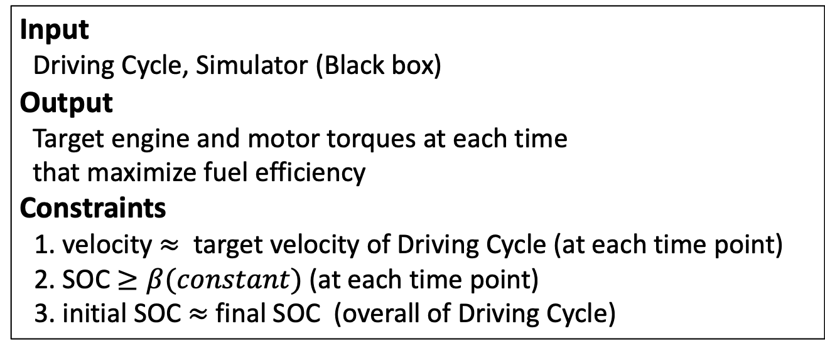
Purpose of Our Study
Construct a HEV control algorithm
with a black-box simulator that
1. maximizes fuel economy efficiency
2. takes small calculation time
3. without controller
Input
Driving Cycle, Simulator (Black box)
Output
Target engine and motor torques at each time
that maximize fuel efficiency
Constraints
1. velocity $≈$ target velocity of Driving Cycle (at each time point)
2. SOC $≥β(constant)$ (at each time point)
3. initial SOC $≈$ final SOC (overall of Driving Cycle)
Notes:
Summarize, the purpose of out study
without controller in order not to limit the search space
is nearly equal

Slide 15
Outline
Background and Problem Setting
Our Proposed Algorithm
  Local Optimization (Optimize in a part of Driving Cycle)
  Global Optimization (Optimize in a whole of Driving Cycle)
  Reduce Calculation Time
Numerical Experiments
Notes:
Here is the outline of my presentation.
First, I talk about
Nest, I explain
Finally, I show the result of Numerical experiments

Slide 16
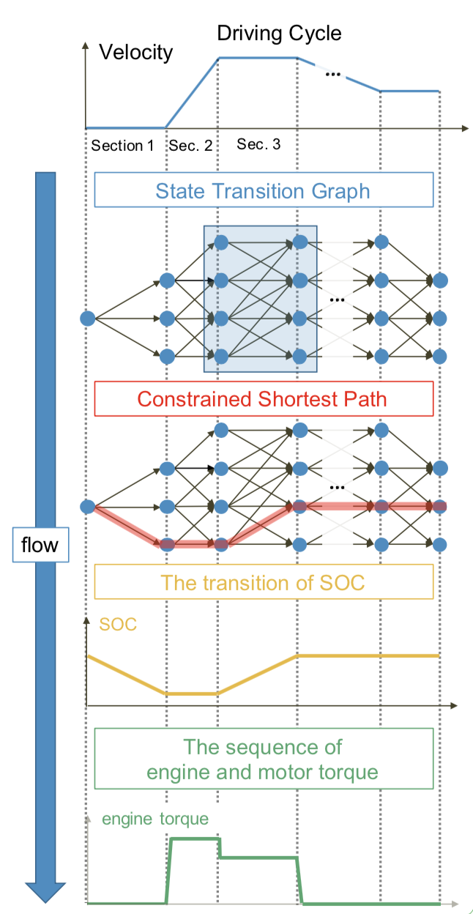
Outline of Solving Strategy
Discretize Driving Cycle
and State of Vehicle
Local
Optimize some vehicle controls in
a part of the Driving Cycle while changing the conditions
with no controller
Construct
State Transition Graph
Global
Obtain vehicle control in the whole of Driving Cycle by solving the constrained shortest path problem on the State Transition Graph
Notes:
I briefly explain the overview of our proposed algorithm.
We divide the problem into small problems by discretize Driving Cycle and states of vehicle.
we optimize some optimal …
next, we construct State Transition Graph based the result of the local optimization.
By solving the constrained shortest path problem on the State Transition Graph,
we select the local control for each sections

Slide 17




Solving Strategy
Discretize the Driving Cycle and the state of vehicle
Driving Cycle
State of vehicles
Set States clusters $H_{1}⋯H_{M}$
by the driving mode and the amount of SOC
Velocity
…
Discretize
HV state
0% ≤ SOC ≤ 10%
EV state
0 %≤ SOC ≤ 10%
section 3
…
section 1
section 2
HV state
10% < SOC ≤ 20%
EV state
10% < SOC ≤ 20%
$$⋮$$
$$⋮$$
Notes:
First of our algorithm, we discretize Driving Cycle into some sections, and set states clusters H1 to Hm …
SOC amount affects the battery charging efficiency
we are going to obtain the optimal controls for each section. Based on these local controls, we aim to obtain the global optimal control overall of Driving Cycle.
And we classify the state of vehicles into M state classes, $H_{1}$ to $H_{M}$.

Slide 18

















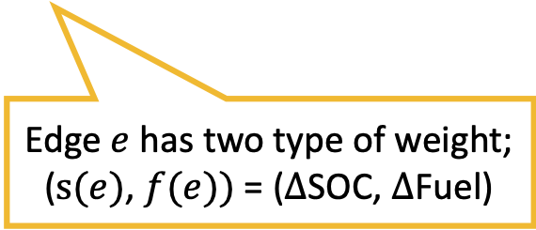


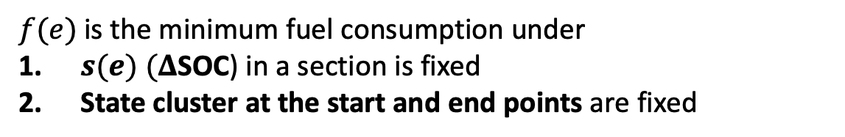




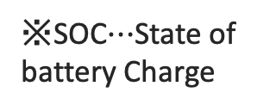
Solving Strategy
Construct State Transition Graph $G = \left(V, E, f, s\right)$; $f, s: E→ℝ$
Nodes represent state clusters of vehicle
Edges represents the transitions of the state of vehicle, SOC and fuel consumption in the section
$${ H}_{M}$$
$${ H}_{M}$$
$${ H}_{M}$$
$${ H}_{M}$$
$$⋮$$
$$⋮$$
$$⋮$$
$$⋮$$
$$H_{0}$$
$$H_{j}$$
$$H_{j}$$
$$⋯$$
$$H_{j}$$
$$H_{j}$$
$$H_{end}$$
$$⋮$$
$$⋮$$
$$⋮$$
$$⋮$$
$$H_{1}$$
$$H_{1}$$
$$H_{1}$$
$$H_{1}$$
Edge $e$ has two type of weight;
($s(e)$, $f(e))$ = ($Δ$SOC, $Δ$Fuel)
※SOC$⋯$State of battery Charge
Section $1$
Section $2$
Section $N$
$Δ⋯$ the change amount of
$f(e)$is the minimum fuel consumption under
$s(e)$ $(Δ$SOC) in a section is fixed
State cluster at the start and end points are fixed
Notes:
nodes prepare the nodes corresponding to the state classes at each section.
Then, we generate the edge which represents the change amount of SOC and fuel consumption when we drive in the section from a certain state.
The edges have two kinds of weights, the change amount of SOC and Fuel consumption.
The value of f(e) is the …
To obtain the value of f(e), we optimize the vehicle control in a section satisfies these constraints.
For example, this orange edge represents that we are able to drive in the section 2 from the state class $H_{1}$ to $H_{j}$ while changing the amount of SOC and fuel consumption following the weights of the edge.

Slide 19
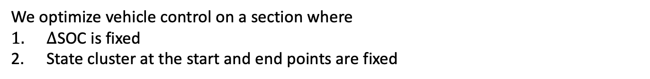
Local: Optimization of Vehicle Control on a Sections
We optimize vehicle control on a section where
$Δ$SOC is fixed
State cluster at the start and end points are fixed
When should we operate the engine in Driving Cycle?
Where should we set the engine operating point?
When
We generate some simple driving patterns of HV and EV
  There exist at most one continuous
  HV and EV driving mode in one section
EV
HV
Section
Notes:
To obtain f(e), we have to consider these two important points.
First, we prepare some simple driving patterns of HV and EV mode, because now we consider a short time span of Driving Cycle to obtain vehicle control.
simple driving patterns means

Slide 20
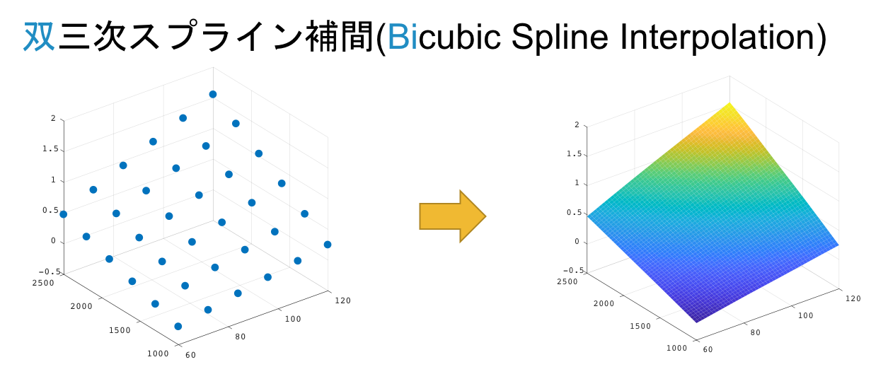
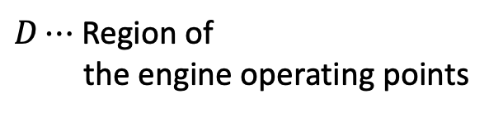

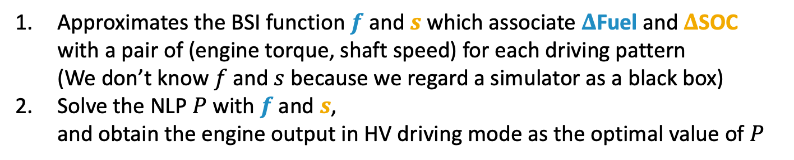

Local: Optimization of Vehicle Control on a Sections
Where
$$Engine output ≈h(torque, shaft speed)$$
Approximates the BSI function $f$ and $s$ which associate $Δ$Fuel and $Δ$SOC
with a pair of (engine torque, shaft speed) for each driving pattern
(We don’t know $f$ and $s$ because we regard a simulator as a black box)
Solve the NLP $P$ with $f$ and $s$,
and obtain the engine output in HV driving mode as the optimal value of $P$
1. Bicubic Spline Interpolation
2. Non-Linear Problem $P$
Sample point data
Approximated
function
$D⋯$ Region of
the engine operating points
Shaft speed
Torque
Notes:
Where should we set the engine operating point?
We use a fact that the engine output and fuel consumption are mainly determined by the engine torque and the engine shaft speed.
Here is the way to determine the engine operating point in HV driving mode.
We use the sample point data in the engine operating region, and based these data, we approximate function using de-Boor algorithm.

Slide 21
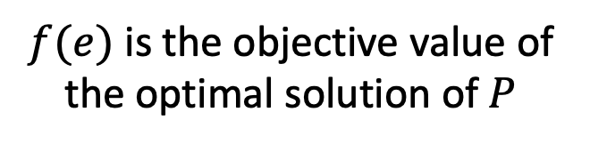

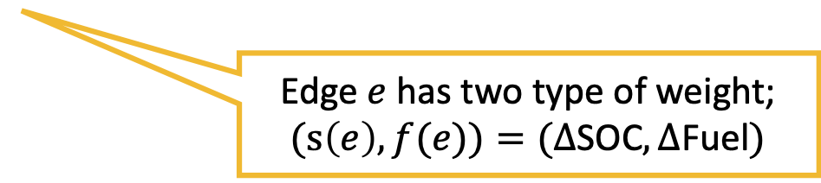
Solving Strategy
Construct State Transition Graph $G = \left(V, E, f, s\right)$; $f, s: E→ℝ$
Nodes represent state clusters of vehicle
Edges represent the transitions of the state of vehicle, SOC and fuel consumption in the section
$${ H}_{M}$$
$${ H}_{M}$$
$${ H}_{M}$$
$${ H}_{M}$$
$$⋮$$
$$⋮$$
$$⋮$$
$$⋮$$
$$H_{0}$$
$$H_{j}$$
$$H_{j}$$
$$⋯$$
$$H_{j}$$
$$H_{j}$$
$$H_{end}$$
$$⋮$$
$$⋮$$
$$⋮$$
$$⋮$$
$$H_{1}$$
$$H_{1}$$
$$H_{1}$$
$$H_{1}$$
Edge $e$ has two type of weight;
$(s\left(e\right), f(e))=(Δ$SOC$, Δ$Fuel$)$
Section $1$
Section $2$
Section $N$
$Δ⋯$ the change amount of
$f(e)$ is the objective value of
the optimal solution of $P$
Notes:
we set f(e) to the objective value of the NLP P.
After generating this State Transition Graph,

Slide 22
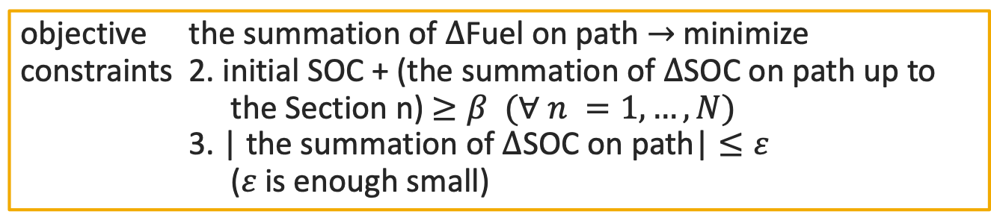
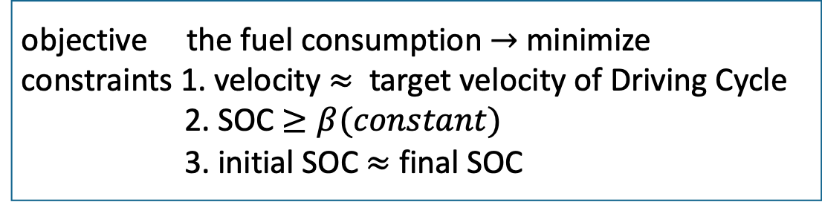
Global: SOC-constrained Shortest Path Problem
original problem
objective the fuel consumption $→$ minimize
constraints 1. velocity $≈$ target velocity of Driving Cycle
2. SOC $≥β(constant)$
3. initial SOC $≈$ final SOC
SOC-constrained shortest path problem
objective the summation of $Δ$Fuel on path $→$ minimize
constraints 2. initial SOC + (the summation of $Δ$SOC on path up to
the Section n) $≥β (∀ n =1,…,N)$
3. | the summation of $Δ$SOC on path| $≤ε$
(𝜀 is enough small)
* constraint 1 is taken into consideration at the time of graph construction
Notes:
we can convert the original problem into the SOC-constrained shortest path problem on this graph.
For example, the objective function of the original problem is converted into the summation of $Δ$Fuel on path, and
the third constraint is converted into that the absolute value of the summation of $Δ$SOC on path is enough small.

Slide 23
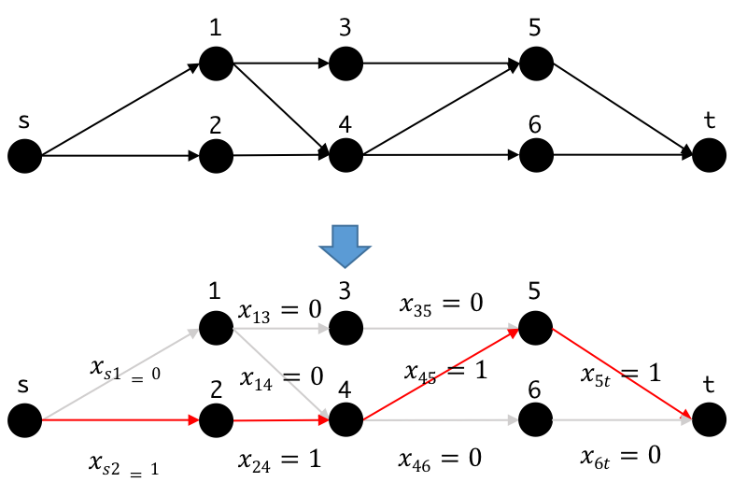


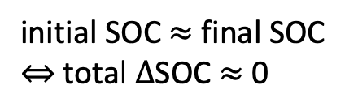


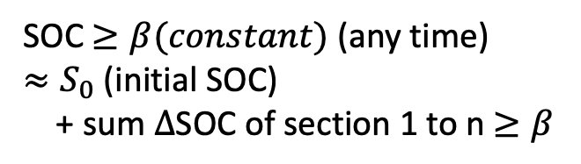
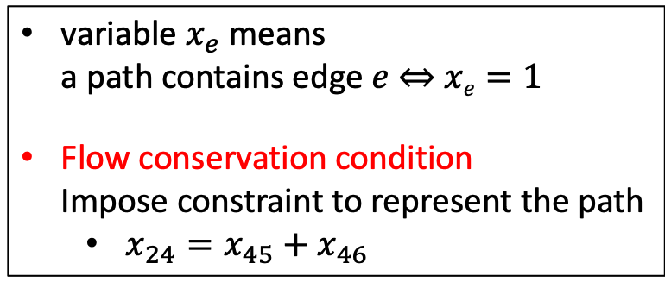


SOC-constrained Shortest Path Problem (0-1ILP)
$$⋯⋯$$
Cumulative $Δ$Fuel
$$⋯$$
Flow conservation
$$⋯⋯$$
initial SOC $≈$ final SOC
$⇔$ total $Δ$SOC $≈$ 0
$$⋯$$
SOC $≥β(constant)$ (any time)
$≈S_{0}$ (initial SOC)
+ sum $Δ$SOC of section 1 to n $≥β$
($E_{j}$ is the set of edges in the section $j$)
variable $x_{e}$ means
a path contains edge $e$ ⇔ $xe=1$
Flow conservation condition
Impose constraint to represent the path
  $x_{24}=x_{45}+x_{46}$
Notes:
We formulated SOC-constrained shortest path problem as 0-1 Integer Linear Programming Problem, like flow problem.
We assign a binary variable $x_{e}$ to every edge $e$ and put flow conservation condition.
The flow conservation condition makes the variable $x_{e}$becomes 1 when a path contains the edge $e$,
and becomes 0 when a path does not contain the edge $e$.

Slide 24
Outline
Background and Problem Setting
Our Proposed Algorithm
  Local Optimization (Optimize in a part of Driving Cycle)
  Global Optimization (Optimize in a whole of Driving Cycle)
  Reduce Calculation Time
Numerical Experiments
Notes:
next,

Slide 25
Reduction of the Search Space and Calculation Time
We solve NLP in the local optimization for every edge
Estimate and sieve inefficient edges from
the State Transition Graph
→ Reduce the local optimization cost
Local
Optimize some optimal vehicle controls in a part of the Driving Cycle while changing the conditions
Notes:
Next, I explain the reduction of the search space and calculation time
In our proposed algorithm, we solve …

Slide 26
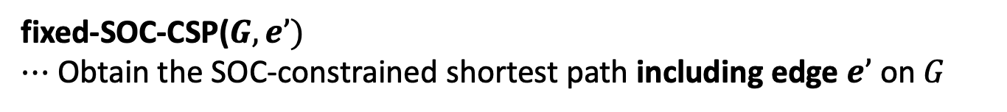
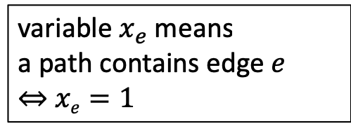
Reduction of the Search Space and Calculation Time
Estimate and sieve inefficient edges from the State Transition Graph
fixed-SOC-CSP($G, e’)$
$⋯$ Obtain the SOC-constrained shortest path including edge $e’$on $G$
variable $x_{e}$ means
a path contains edge $e$
⇔ $xe=1$
Notes:
we define the fixed-SOC-CSP
this problem obtains
because variable $x_{e}$ = 1 means a path contains edge $e$

Slide 27



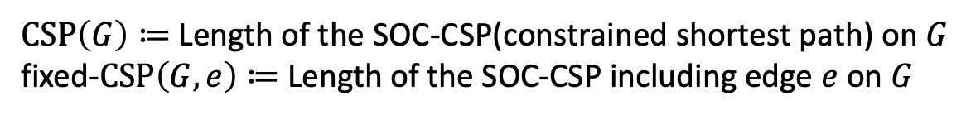
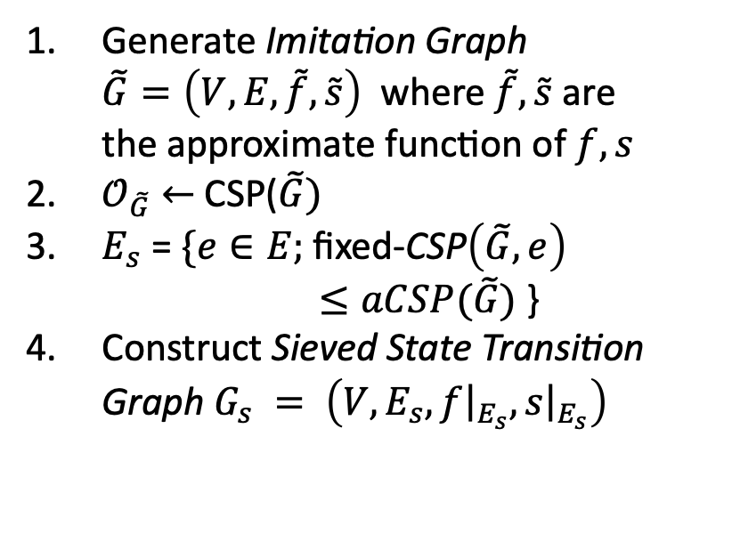
Reduction of the Search Space and Calculation Time
Estimate and sieve inefficient edges from the State Transition Graph
$CSP\left(G\right)≔$ Length of the SOC-CSP(constrained shortest path) on $G$
fixed-$CSP\left(G, e\right)≔$ Length of the SOC-CSP including edge $e$ on $G$
Procedure of Sieving Edges
$$E$$
Generate Imitation Graph
$\tilde{G}=\left(V, E, \tilde{f}, \tilde{s}\right)$ where $\tilde{f},\tilde{s}$are
the approximate function of $f, s$
$𝒪_{\tilde{G}}$ $←$ CSP($\tilde{G})$
$E_{s}$ = $\{e∈E;$ fixed-CSP$\left(\tilde{G},e\right)$
$≤aCSP(\tilde{G})$ }
Construct Sieved State Transition
Graph $G_{s} = \left(V, E_{s}, f{\left.​\right|}_{E_{s}}, s{\left.​\right|}_{E_{s}}\right)$
$$E_{s}$$
$a⋯$ reducing parameter
Notes:
Let CSP(G) be length …, and let fixed-CSP(G) be …
we generate imitation graph …
define the set of edge satisfies the fixed-CSP(G-tilde, e) ≤ a CSP(G-tilde)

Slide 28
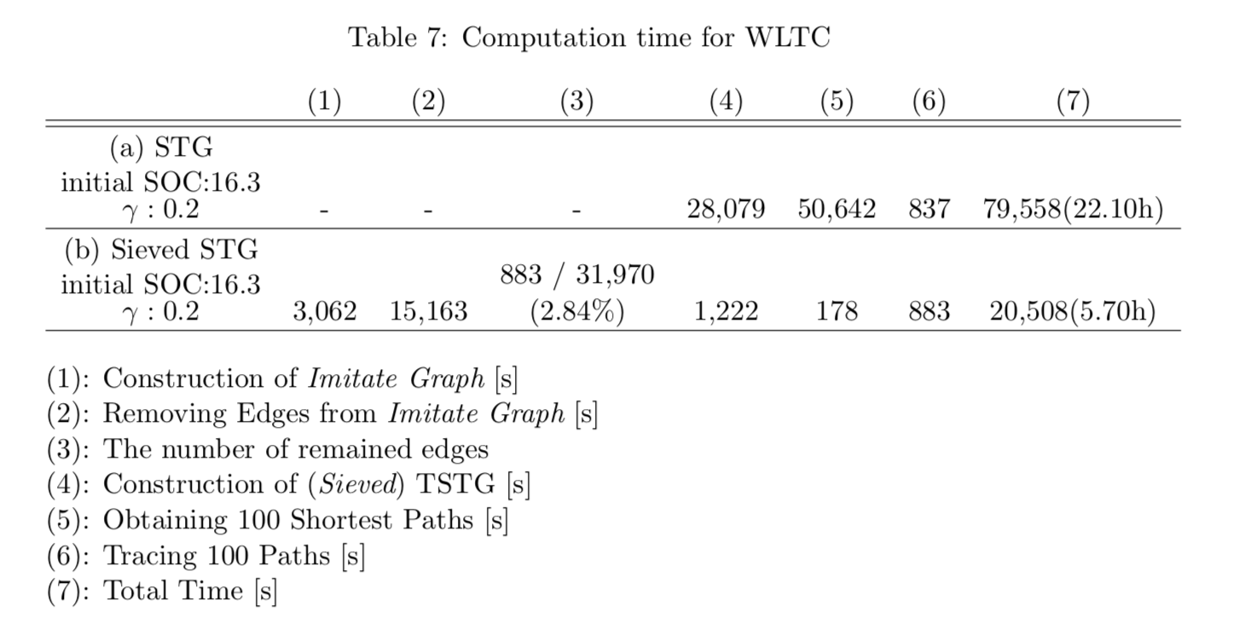
Reduction of the Search Space and Calculation Time
A result of Sieve Algorithm
# remained edges
/ # edge of Imitation Graph
( = # edge of STG)
Total calculation time
Notes:
We succeed the reduce the number of edge, and reduce total calculation time in this table.
the total of (1) and (2) is the time to generate Imitation graph, and
the total of (4) – (6) is the time to generate State Transition Graph

Slide 29
Outline
Background and Problem Setting
Our Proposed Algorithm
  Local Optimization (Optimize in a part of Driving Cycle)
  Global Optimization (Optimize in a whole of Driving Cycle)
  Reduce Calculation Time
Numerical Experiments
Notes:
Finally, I show the result of the numerical experiments

Slide 30
Result of our proposed algorithm
Driving Cycle: WLTC, SOC lower bound($β$): 10%
Case | initial SOC | final SOC | fuel consumption
1 | 16.30 % | 16.30 % | 518.34 g
2 | 12.00 % | 12.01 % | 520.42 g
Notes:
Finally, we show the result of our proposed algorithm.
This show the 2 case of the result.
We use WLTC Driving Cycle, and we set 𝛽 to 10%, that is the vehicle should always keep SOC above 10%.
Orange Case 1 is the case that started driving with 16.3% SOC.
Blue Case 2 is the case that started driving with 12% SOC.
We succeeded to obtain the car control satisfies the two SOC constraints of the original problem.
One is that Initial SOC and final SOC were nearly equal shown in the table.
And the other is SOC always kept above 10% shown in the fourth figure. This figure shows the transition of SOC of experiments.
The first and second figure shows the transition of engine torque of Case 1 and Case 2, respectively.
Case 2 started driving with 12% SOC, so in order not SOC to fall below 10%, Case 2 drives to charge the battery earlier than Case 1 by increasing the HV driving section.

Slide 31

Result of our proposed algorithm
Driving Cycle: WLTC, SOC lower bound($β$): 10%
Case | initial SOC | final SOC | fuel consumption
1 | 16.30 % | 16.30 % | 518.34 g
2 | 12.00 % | 12.01 % | 520.42 g
initial SOC $≈$ final SOC
Notes:
One is that Initial SOC and final SOC were nearly equal shown in the table.

Slide 32

Result of our proposed algorithm
Driving Cycle: WLTC, SOC lower bound($β$): 10%
Case | initial SOC | final SOC | fuel consumption
1 | 16.30 % | 16.30 % | 518.34 g
2 | 12.00 % | 12.01 % | 520.42 g
SOC $≥β=10\%$
Notes:
And the other is SOC always kept above 10% shown in the fourth figure. This figure shows the transition of SOC of experiments.

Slide 33
Result of our proposed algorithm
Driving Cycle: WLTC, SOC lower bound($β$): 10%
Case | initial SOC | final SOC | fuel consumption
1 | 16.30 % | 16.30 % | 518.34 g
2 | 12.00 % | 12.01 % | 520.42 g
In Case 2, engine have to work in inefficient section to keep SOC ≥ 10%
Notes:
The first and second figure shows the transition of engine torque of Case 1 and Case 2, respectively.
Case 2 started driving with 12% SOC, so in order not SOC to fall below 10%, Case 2 drives to charge the battery earlier than Case 1 by increasing the HV driving section.
Because of that, the fuel consumption of case 2 is greater than case 1

Slide 34
Summarize
(Local) Analyze engine efficiency
by Bicubic Spline Interpolation and
obtain optimal engine output by solving NLP
(Global) Obtain the state transition of the optimal car control by solving
the SOC-constrained shortest path problem on the State Transition Graph formulated as 0-1ILP
Reducing the search space and calculation time by using Imitation Graph
Our algorithm does not depend on simulator and Driving Cycle
Notes:
Here is the main points of my presentation.
Thank you for your time and attention.
Do you have any question?

