Slide 1
Map-Matching using
Shortest Path Algorithms on Time-Expanded Graph
Akira Tanaka¹, Shota Osafune¹, Nozomi Hata¹, Takashi Nakayama¹, Nariaki Tateiwa¹, Akihiro Yoshida¹ and Katsuki Fujisawa^{2,3}
¹Graduate school of mathematics, Kyushu University, Fukuoka, Japan
²Institute of Mathematics for Industry, Kyushu University, Fukuoka, Japan
³AIST-Tokyo Tech Real World Big-Data Computation Open Innovation Laboratory, Tokyo, Japan
2019/03/28
The 4th IMI-ISM-ZIB MODAL Workshop Mathematical Optimization and Data Analysis
@ The Institute of Statistical Mathematics, Tokyo, Japan
Notes:
Thank you for your introduction.
I’m a Ph.D student of mathematics at Kyushu University.
Today, I’d like to talk about a map-matching algorithm well-balanced with respect to accuracy and speed.

Slide 2
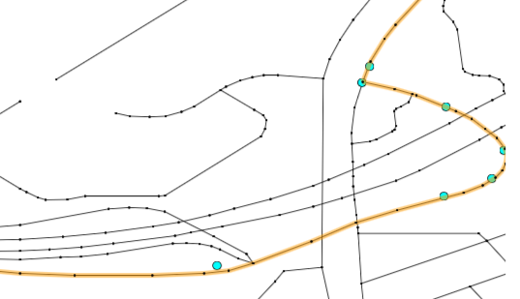
Contents
What is Map-Matching?
Dataset / Formulation
Related Work
Motivation
Proposed Algorithm
Experiment
Summary
Matching Path
Find Neighborhood
Solve shortest path
on time-expanded graph
Notes:
Here is the contents of my presentation.
I firstly explain the definition of map-matching and characteristics of data.
Then, I introduce previous work and propose our algorithm robust against partial GPS errors.
Finally, we compare accuracy and speed between our algorithm and previous one by using real data
So, let me begin.

Slide 3
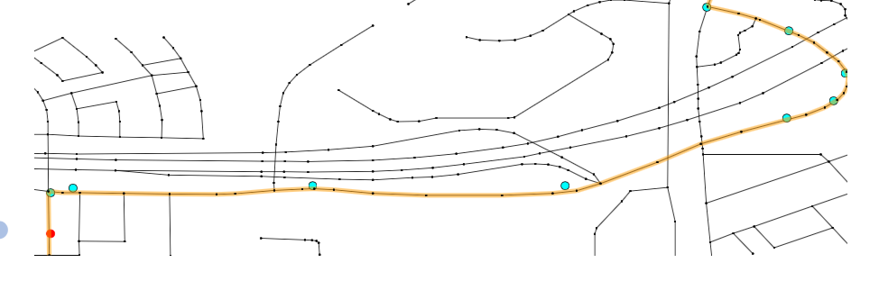



What is Map-Matching ?
Map-Matching is the process to restore the vehicle trajectory based on positioning data
Incremental (similar to online object tracking)
  Used for navigation system, congestion detection
$$t=1$$
$$t=2$$
$$t=3$$
GPS
prediction
Global (similar to a long-term tracking)
Used for optimization of transportation system, urban planning
GPS
Matching path
Notes:
Map matching is the process to restore the vehicle trajectory based on positioning data such as GPS data, Wi-fi, and so on.
Needless to say, positioning data contains some measurement errors,
thus we need to obtain the matching path resembling the GPS trajectory as a whole
There are two types of algorithms.
First, incremental algorithm calculate the vehicle trajectory every time positioning data arrives, and this algorithm is used for navigation system, congestion detection, and so on.
On the other hand, global map-matching is offline algorithm, which provides the matching path based on the all positioning data. Therefore global map-matching is usually more accurate than the incremental one, and it is used for optimization of transportation system and urban planning.

Slide 4
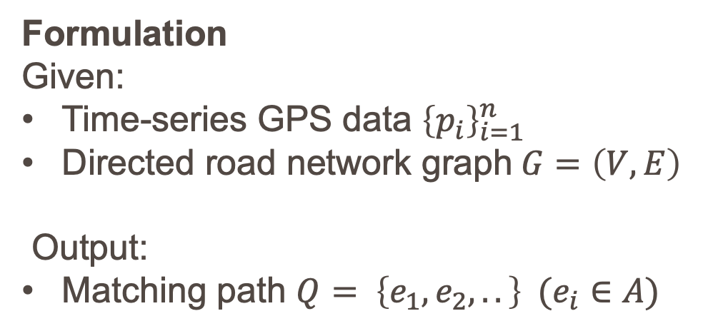




Dataset / Formulation
Dataset
GPS data is obtained for every
200m
or
45° change in direction
$$p_{1}$$
$$p_{6}$$
Within
200m
Formulation
Given:
Time-series GPS data ${\left\{p_{i}\right\}}_{i=1}^{n}$
Directed road network graph$G=\left(V, E\right)$
Output:
Matching path $Q= \left\{e_{1},e_{2},..\right\} (e_{i}∈A)$
$$p_{2}$$
$$p_{5}$$
≥45°
Notes:
Now, let me touch on the Dataset and formulation of map-matching
We use real GPS data in Japan, which is obtained for every 200m or 45 degree change in direction shown in the figure.
Formulation of map-matching is as follows.
Inputs are time-series GPS data from $p_{1}$ to $p_{n}$ and a directed road network graph G whose set of intersections and road segments are denoted by $V$ and $A$, respectively.
Output is a map matching path $Q$, which is a sequence of road segment.

Slide 5
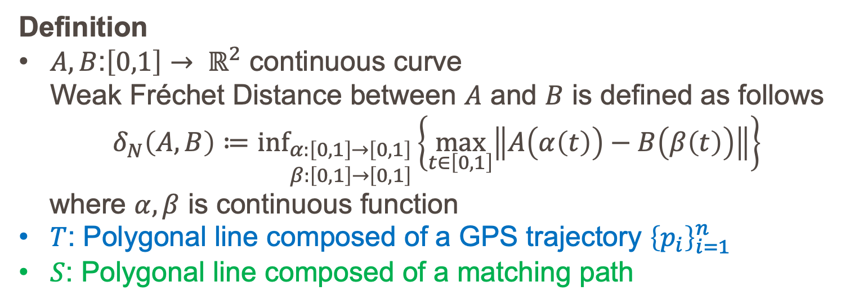
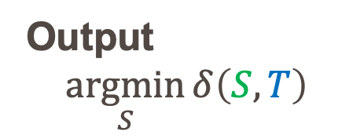
Related Work^{[1]}
Definition
$A,B$:$\left[0,1\right]→ ℝ^{2}$ continuous curve
Weak Fréchet Distance between $A$ and $B$ is defined as follows
$$δ_{N}\left(A,B\right)≔{\text{inf}}_{\begin{aligned}α:\left[0,1\right]→\left[0,1\right] \\ β:\left[0,1\right]→\left[0,1\right]\end{aligned}}\left\{\max_{t∈\left[0,1\right]}\left\|A\left(α\left(t\right)\right)−B\left(β\left(t\right)\right)\right\|\right\}$$
where $α, β$ is continuous function
$T$: Polygonal line composed of a GPS trajectory ${\left\{p_{i}\right\}}_{i=1}^{n}$
$S$: Polygonal line composed of a matching path
Output
$$\underset{S}{argmin}{δ\left(S,T\right)}$$
Accurate but Slow
[1] HELMUT ALT and MICHAEL GODAU. COMPUTING THE FRÉCHET DISTANCE BETWEEN TWO POLYGONAL CURVES. International Journal of Computational Geometry & Applications
Notes:
Now, lets move on to the related work.
Previous work has explored a global matching algorithm based on a weak Fréchet distance,
which is used to measure the similarity between given two curves.
A common illustration of the Fréchet distance is as follows:
Suppose a person is walking with a dog.
The person is walking on the one black curve and the dog on the blue one,
and the person is holding the dog at a leash.
Both are allowed to control their speeds and allowed to go backwards.
Then, Fréchet distance is the minimum length of the leash to take the dog for a walk.
Regarding the map-matching, the previous work devices the algorithm to calculate the matching path
which minimizes the weak Fréchet distance for the given GPS trajectory.
Although it is fairly accurate, but it has a large computation time.
However, we need to complete the map-matching process quickly because a lot of GPS data are gathered from many vehicles.
Therefore we propose a fast and accurate algorithm.
Fréchet(フレシェット)

Slide 6










Motivation
Well-balanced algorithm with respect to
Accuracy
Robust against “Partial GPS errors” and “Division of edges”
Speed
Matching Path
Influenced by $p_{1}$, $p_{1}$
GPS errors
$$p_{1}$$
$$p_{2}$$
GPS error
$$p_{3}$$
$$p_{1}$$
$$p_{2}$$
$$p_{3}$$
Actual Path
Path similar to a
GPS trajectory
$$p_{1}$$
$$p_{2}$$
Matching Path
$$p_{3}$$
${\left\{p_{i}\right\}}_{i=1}^{n}$:time-series GPS data
Notes:
Our algorithm is well-balanced with respect to accuracy and speed,
and robust against partial GPS errors and division of edges
This figure explains the influence of partial GPS errors.
Suppose the car travels from the left side to the right side through the lower road, and GPS errors are large at time step 1 and 2.
If we are influenced these errors, we obtain an incorrect matching path shown in upper right figure.
On the other hand, if we obtain the path similar to the GPS trajectory as a whole,
The path is a probably correct one shown in lower right figure.
Title->Contents-> Definition of Map-Matching -> Dataset/Formulation -> Motivation

Slide 7
Proposed Algorithm
Procedure
For each GPS data, search for potential edges where a car could run on → Fractional Cascading
Construct the time-expanded graph
Obtain a shortest path on the time-expanded graph
1. Potential edges
2,3.Shortest path
on time-expanded graph
Notes:
Now, let's move on to the proposed algorithm.
There are three procedures of the algorithm.
First, for each GPS data, we search for potential edges where a could run on,
and this process is accelerated by utilizing fractional cascading.
Second, we construct time-expanded graph.
Finally, we solve a shortest path on the time expanded graph

Slide 8
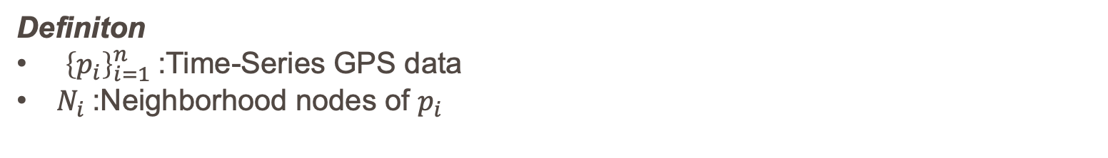



Construct Time-Expanded Graph
Definiton
${\left\{p_{i}\right\}}_{i=1}^{n}$:Time-Series GPS data
$N_{i}$:Neighborhood nodes of $p_{i}$
$$p_{1}$$
$$p_{2}$$
$$p_{3}$$
Notes:
Now I’ll elaborate on construction of time-expanded graph.
Let $p_{i}$ be time-series GPS data where $i$ represents a time step.
$N_{i}$ is the neighborhood nodes of $p_{i}$ , and in our research, it is the set of nodes in a square centered at $p_{i}$.
For example, the neighborhood nodes of $p_{1}$ are two blue nodes,
and the neighborhood node of $p_{3}$ is a green node.

Slide 9


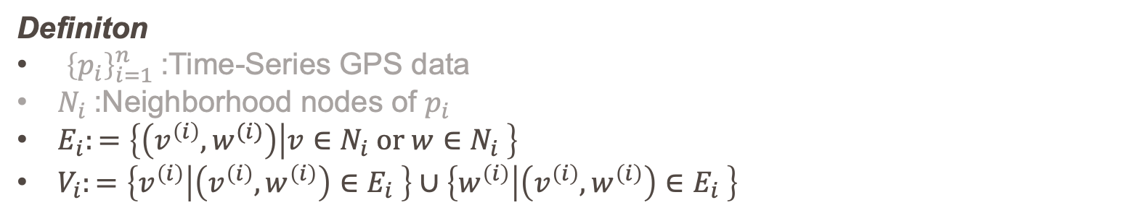

Construct Time-Expanded Graph
Definiton
${\left\{p_{i}\right\}}_{i=1}^{n}$:Time-Series GPS data
$N_{i}$:Neighborhood nodes of $p_{i}$
$E_{i}:=\left\{\left(v^{\left(i\right)},w^{(i)}\right) | v∈N_{i} or w∈N_{i} \right\}$
$V_{i}:=\left\{v^{\left(i\right)} | \left(v^{\left(i\right)},w^{\left(i\right)}\right)∈E_{i} \right\}∪\left\{w^{\left(i\right)} | \left(v^{\left(i\right)},w^{\left(i\right)}\right)∈E_{i} \right\}$
$$p_{1}$$
$$p_{2}$$
$$p_{3}$$
$$V_{1}, E_{1}$$
Notes:
For each time step $i$, we also define $E_{i}$ and $V_{i}$ which are potential edges and nodes where the car could pass through at time step $i$.
Formally, $E_{i}$ is the set of edges whose tail or head is included in $N_{i}$,
and $V_{i}$ is the set of nodes induced by $E_{i}$.
For instance, $V_{1}$ and $E_{1}$ are represented by blue nodes and edges, respectively.

Slide 10



Construct Time-Expanded Graph
Definiton
${\left\{p_{i}\right\}}_{i=1}^{n}$:Time-Series GPS data
$N_{i}$:Neighborhood nodes of $p_{i}$
$E_{i}:=\left\{\left(v^{\left(i\right)},w^{(i)}\right) | v∈N_{i} or w∈N_{i} \right\}$
$V_{i}:=\left\{v^{\left(i\right)} | \left(v^{\left(i\right)},w^{\left(i\right)}\right)∈E_{i} \right\}∪\left\{w^{\left(i\right)} | \left(v^{\left(i\right)},w^{\left(i\right)}\right)∈E_{i} \right\}$
$$p_{1}$$
$$p_{2}$$
$$p_{2}$$
$$p_{3}$$
$$V_{2}, E_{2}$$
$$V_{3}, E_{3}$$
Notes:
In the same manner, $V_{2}$ and $E_{2}$ are orange nodes and edges, and $V_{3}$ and $E_{3}$ are green ones.

Slide 11


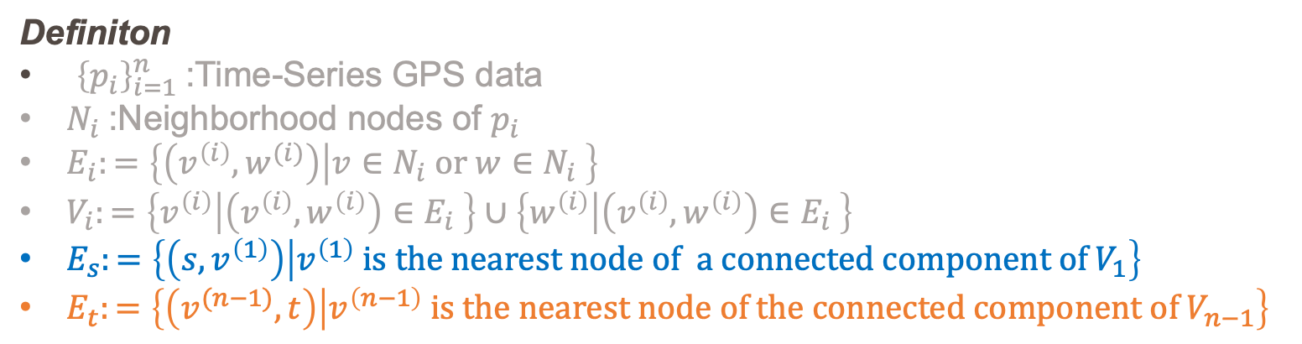
Construct Time-Expanded Graph
Definiton
${\left\{p_{i}\right\}}_{i=1}^{n}$:Time-Series GPS data
$N_{i}$:Neighborhood nodes of $p_{i}$
$E_{i}:=\left\{\left(v^{\left(i\right)},w^{(i)}\right) | v∈N_{i} or w∈N_{i} \right\}$
$V_{i}:=\left\{v^{\left(i\right)} | \left(v^{\left(i\right)},w^{\left(i\right)}\right)∈E_{i} \right\}∪\left\{w^{\left(i\right)} | \left(v^{\left(i\right)},w^{\left(i\right)}\right)∈E_{i} \right\}$
$E_{s}:=\left\{\left(s,v^{\left(1\right)}\right) | v^{\left(1\right)} is the nearest node of a connected component of V_{1}\right\}$
$E_{t}:=\left\{\left(v^{(n−1)},t\right) | v^{\left(n−1\right)} is the nearest node of the connected component of V_{n−1}\right\}$
$$p_{1}$$
$$p_{2}$$
$$p_{3}$$
$$s$$
connected component
$$t$$
Notes:
Next, we add source node $s$, and for each connected component, we connect the source to the nearest node of each component.
We do the same thing for the sink node $t$.

Slide 12


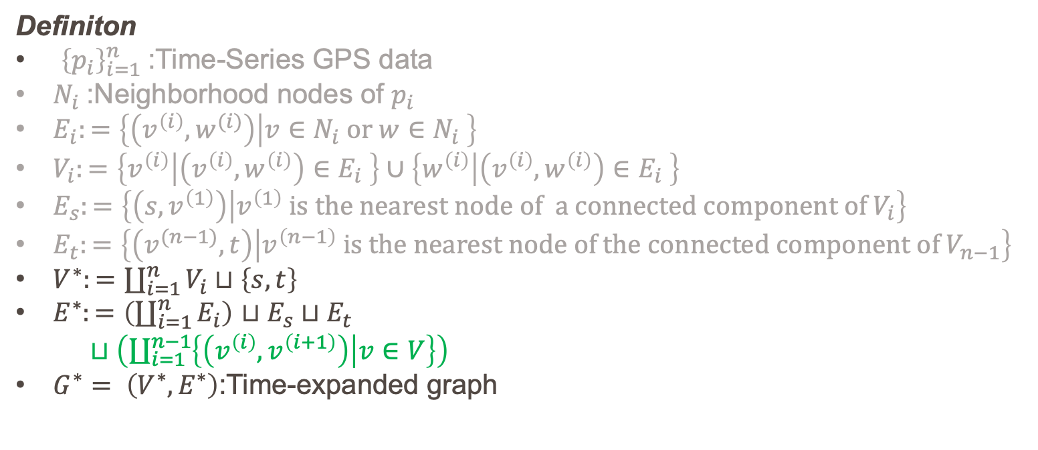
Construct Time-Expanded Graph
Definiton
${\left\{p_{i}\right\}}_{i=1}^{n}$:Time-Series GPS data
$N_{i}$:Neighborhood nodes of $p_{i}$
$E_{i}:=\left\{\left(v^{\left(i\right)},w^{(i)}\right) | v∈N_{i} or w∈N_{i} \right\}$
$V_{i}:=\left\{v^{\left(i\right)} | \left(v^{\left(i\right)},w^{\left(i\right)}\right)∈E_{i} \right\}∪\left\{w^{\left(i\right)} | \left(v^{\left(i\right)},w^{\left(i\right)}\right)∈E_{i} \right\}$
$E_{s}:=\left\{\left(s,v^{\left(1\right)}\right) | v^{\left(1\right)} is the nearest node of a connected component of V_{i}\right\}$
$E_{t}:=\left\{\left(v^{(n−1)},t\right) | v^{\left(n−1\right)} is the nearest node of the connected component of V_{n−1}\right\}$
$V^{∗}:=\coprod_{i=1}^{n}{V_{i}}⊔\left\{s,t\right\}$
$E^{∗}:=\left(\coprod_{i=1}^{n}{E_{i}}\right)$ $⊔E_{s}⊔E_{t}$
$⊔\left(\coprod_{i=1}^{n−1}{\left\{\left(v^{\left(i\right)},v^{\left(i+1\right)}\right) | v∈V\right\}}\right)$
$G^{∗}= \left(V^{∗}, E^{∗}\right)$:Time-expanded graph
$$p_{1}$$
$$p_{2}$$
$$p_{3}$$
$$s$$
$$t$$
Notes:
Finally, we connect common neighborhood nodes on consecutive layers, and the time-expanded graph is constructed.
I note that time-expanded graph is denoted by $G^{∗}$

Slide 13
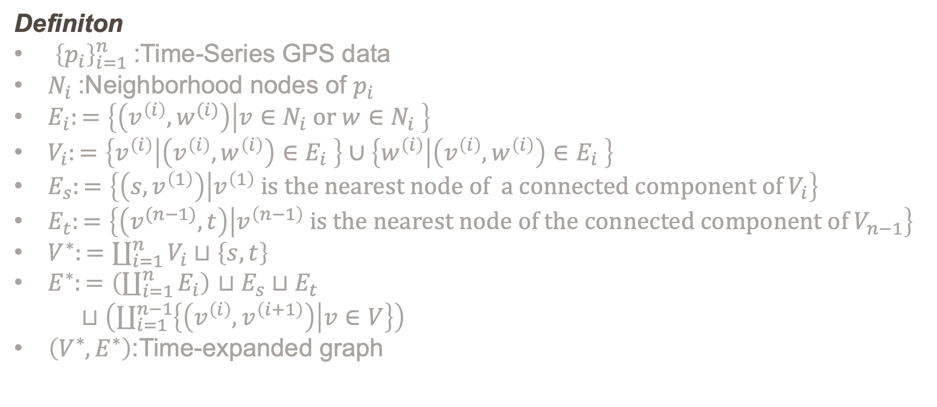

Construct Time-Expanded Graph
Definiton
${\left\{p_{i}\right\}}_{i=1}^{n}$:Time-Series GPS data
$N_{i}$:Neighborhood nodes of $p_{i}$
$E_{i}:=\left\{\left(v^{\left(i\right)},w^{(i)}\right) | v∈N_{i} or w∈N_{i} \right\}$
$V_{i}:=\left\{v^{\left(i\right)} | \left(v^{\left(i\right)},w^{\left(i\right)}\right)∈E_{i} \right\}∪\left\{w^{\left(i\right)} | \left(v^{\left(i\right)},w^{\left(i\right)}\right)∈E_{i} \right\}$
$E_{s}:=\left\{\left(s,v^{\left(1\right)}\right) | v^{\left(1\right)} is the nearest node of a connected component of V_{i}\right\}$
$E_{t}:=\left\{\left(v^{(n−1)},t\right) | v^{\left(n−1\right)} is the nearest node of the connected component of V_{n−1}\right\}$
$V^{∗}:=\coprod_{i=1}^{n}{V_{i}}⊔\left\{s,t\right\}$
$E^{∗}:=\left(\coprod_{i=1}^{n}{E_{i}}\right)$ $⊔E_{s}⊔E_{t}$
$⊔\left(\coprod_{i=1}^{n−1}{\left\{\left(v^{\left(i\right)},v^{\left(i+1\right)}\right) | v∈V\right\}}\right)$
$\left(V^{∗}, E^{∗}\right)$:Time-expanded graph
$$p_{1}$$
$$p_{2}$$
$$p_{3}$$
$$s$$
Fail to reach sink $t$ from upper road
Obtain the correct path
Robust against partial GPS errors
$$t$$
Notes:
In this time-expanded graph, we must pay attention to the fact that if we try to run on the upper road,
which is denoted green one, we surely fail to reach sink $t$ due to disconnection.
Therefore, we can obtain the lower path as the matching result,
which implies that our algorithm is robust against partial GPS errors.

Slide 14







Weight of the Time-Expanded Graph
Assume that the car runs on edges of $E_{i}$when $p_{i}$ is obtained
Desirable Property of Weight
The closer the edge and GPS are, the smaller weight of edge is
Dividing edges has no influence to the total value of weights
１.
2.
large weight
$$p_{i}$$
ー
$$e_{1}$$
far
$$p_{i}$$
$$p_{i}$$
close
ー
$$e_{2}$$
$$e_{3}$$
small weight
$${w(e}_{1})=w(e_{2})+{w(e}_{3})$$
Notes:
Now, let’s to move on to the way to decide the weight of the time-expanded graph.
Considering the construction of time-expanded graph, it is natural to assume that the car runs on edges of $E_{i}$ when GPS $p_{i}$ is obtained.
Therefore, there are two desirable property for the weight of the edge in $E_{i}$
First, the closer the edge and $p_{i}$ are, the smaller weight of edge is as shown in left side in the slide.
Second, the proposed algorithm should provide the same matching path even if we divide edges.
To satisfy the property, total value of weights of edges needs to be same before and after dividing edges.

Slide 15


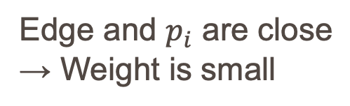












Weight of the Time-Expanded Graph
$$\text{Area} \text{of} \text{triangle} \text{consisting} \text{of} p \text{and} \text{edge} e$$
$$\text{(}e∈E_{i}\text{)}$$
$$w\left(e\right)=$$
$$0$$
$$\text{(}\text{tail}\left(e\right)∈E_{i}, \text{head}\left(e\right)∈E_{i+1}\text{)}$$
large weight
$$w\left(e\right)>0$$
$$p_{i}$$
$$w\left(e\right)=0$$
$$p_{i}$$
$$e_{1}$$
$$p_{i+1}$$
small weight
Weight of edge
connecting layers is 0
Edge and $p_{i}$ are close
→ Weight is small
$$p_{i}$$
$$e_{2}$$
$$e_{3}$$
$${w(e}_{1})=w(e_{2})+{w(e}_{2})$$
Notes:
Formally, we define the weight of edge as the area of triangle
consisting GPS point and edge if the edge is the element of $E_{i}.$
Otherwise, that is if the edge is connecting consecutive layers, we set the weight of the edge as 0.
Then, we confirm that this definition satisfies the two desirable property mentioned the previous slide.
If the edge and GPS are close, the weight is small.
Dividing edges has no influence on the total value of weights of edges.

Slide 16




Appropriate Size of Neighborhood
Too small neighborhood causes disconnection of layers
→ Obtain no matching path
$$p_{i}$$
$$p_{i+1}$$
$$p_{i+2}$$
$$p_{i+3}$$
Actual Path
Notes:
Next, we consider the appropriate size of neighborhood.
In this slide, we observe an example that we fail to obtain any path in time-expanded graph.
Suppose the car travels from the left side to the right side and make a U-tern.
We also assume that the neighborhoods are too small as shown in figure.

Slide 17







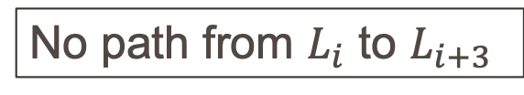

Appropriate Size of Neighborhood
Too small neighborhood causes disconnection of layers
→ Obtain no matching path
$$p_{i}$$
$$p_{i}$$
$$L_{i}$$
disconnection
$$p_{i+1}$$
$$p_{i+2}$$
$$p_{i+3}$$
$$p_{i+1}$$
$$L_{i+1}$$
Actual Path
$$p_{i+2}$$
$$L_{i+2}$$
No path from $L_{i}$ to $L_{i+3}$
$$p_{i+2}$$
$$L_{i+3}$$
Notes:
The time-expanded graph is shown in right figure.
In this case, there are no common nodes between neighborhood of $p_{i}$ and $p_{i+1}$
Therefore time-expanded graph has a disconnection between $L_{i}$ and $L_{i+1}$,
which leads to the fail obtaining a matching path

Slide 18






Appropriate Size of Neighborhood
Too large neighborhood causes shortcut path
→ Obtain inappropriate path
Actual
$$s$$
Shortest Path
Every neighborhood
contains all edges
$$L_{1}$$
$$L_{2}$$
$$L_{3}$$
Actual
Shortest Path
If the current GPS is near the previous one,
the previous neighborhood should be small
$$L_{4}$$
$$t$$
Notes:
On the other hand, too large neighborhood results in obtaining incorrect path.
Suppose every neighborhood is too large, and it contains all edges in the graph.
The corresponding time-expanded graph is shown in the right figure.
I note that every layer has all nodes and every node is connected to the next layer.
In this case, if we solve the shortest path problem on the time-expanded graph, we get the wrong path described in orange line.
This is because if we try to go thorough the actual path, the weights of two blue triangle are added, which leads to a long path.
Therefore the shortest path ignores the GPS data at time 2 and 3, and it becomes a shortcut path.
To avoid this situation, if the current GPS is near the previious one, the neighborhood should be small
or we should change connecting rule of consecutive layers.

Slide 19
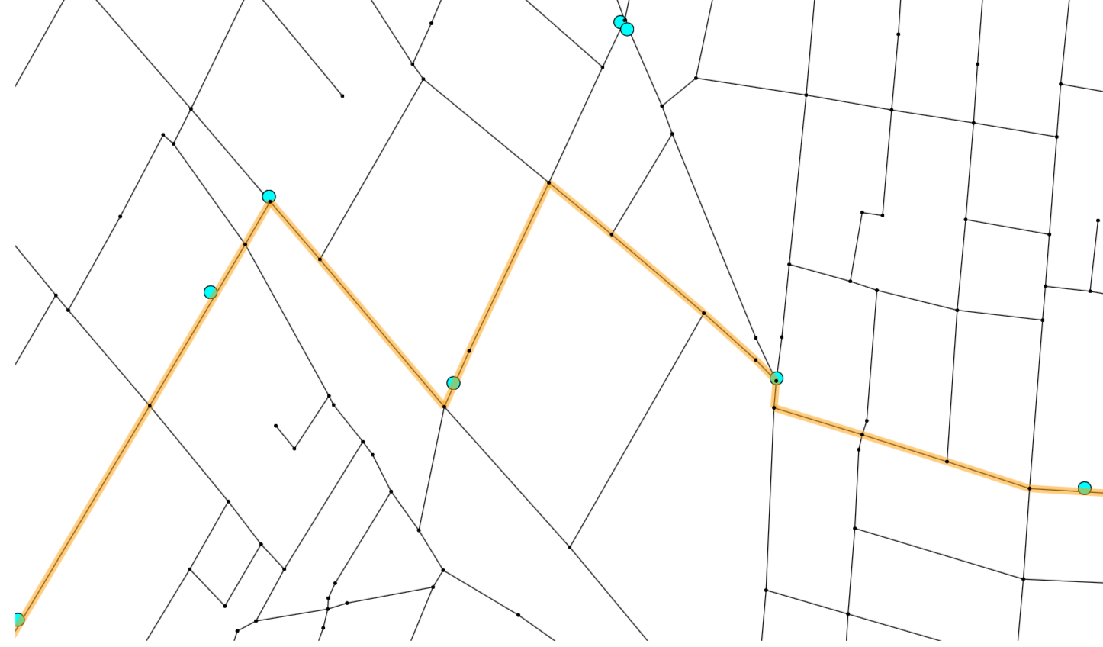
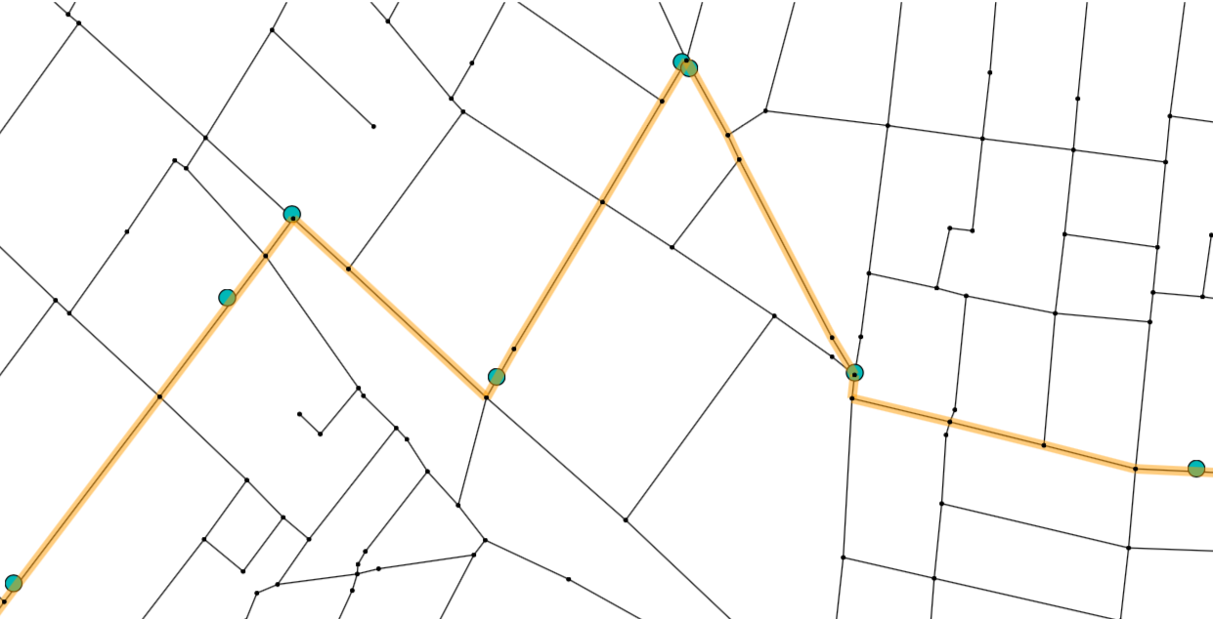
Appropriate Size of Neighborhood
Original
Modified
Shortcut Path
Current GPS is closer to
the previous one
Neighborhood
→Square 200m on a side
Rule of connecting Layer:
Nodes induced by neighborhood edges
Neighborhood:
Square 50m on a side
if the current GPS is closer than 80m
Rule of connecting Layer:
Neighborhood nodes
200m
50m
Notes:
This is an example of changing a neighborhood size and rule of connecting consecutive layers.
The left figure shows the matching path when we use a square 200m on a side as a neighborhood.
In this case, the matching path becomes shortcut path as I mentioned before.
To prevent the situation, in the right figure, we reduce the size of neighborhood if the current GPS is closer to the previous one.
We also change the rule of connecting consecutive layers.
In connecting layers, we connect common neighborhood nodes between layers instead of nodes induced neighborhood edges shown in the lower figure.

Slide 20
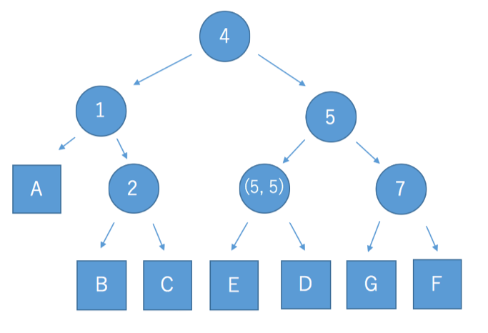
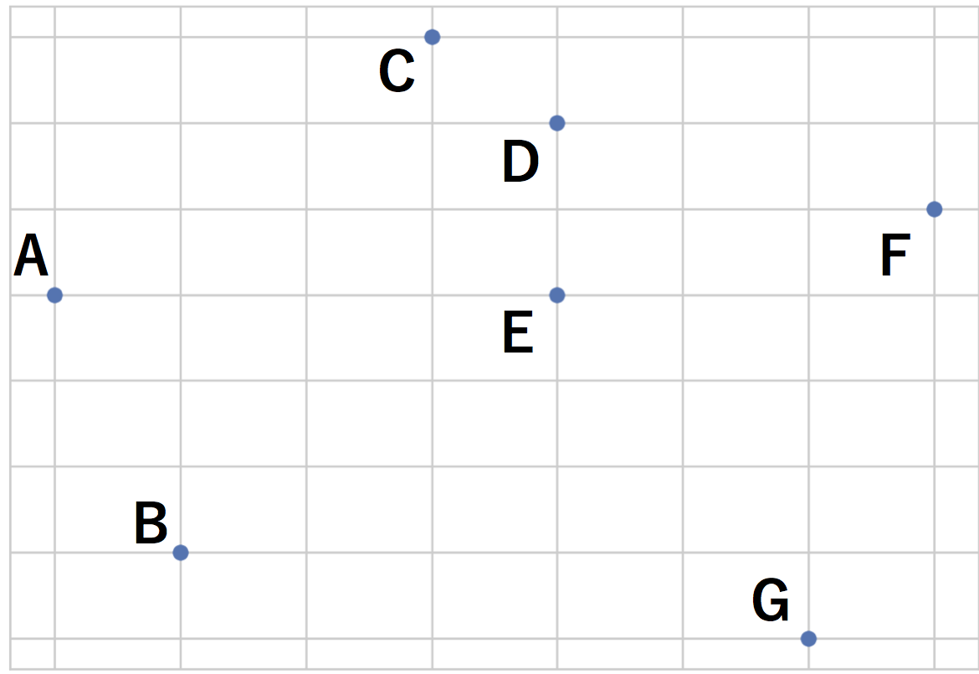
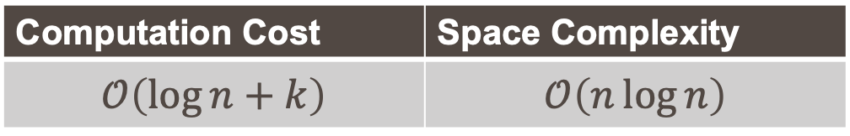

Fractional Cascading
Fractional Cascading…
Data structuring technique designed to speed up a search for points in the given rectangle area
Binary search on the Y-axis is automatically achieved by implementing the binary search on the X-axis
Computation Cost | Space Complexity
$$𝒪\left(\log{n}+k\right)$$ | $$𝒪\left(n\log{n}\right)$$
$n$:number of the data
$k$:number of pints in the given rectangle area
B,E
Notes:
Now let’s move on to the technique finding the neighborhood of a GPS
In order to construct the time-expanded graph more quickly, we employ a fractional cascading, which is data structuring technique designed to speed up a search for nodes in the given rectangle area
The most important strategy of this data structure is that
binary search on the Y-axis is automatically achieved by implementing the binary search on the X-axis
In stead of high space complexity, it accelerates the neighborhood search

Slide 21
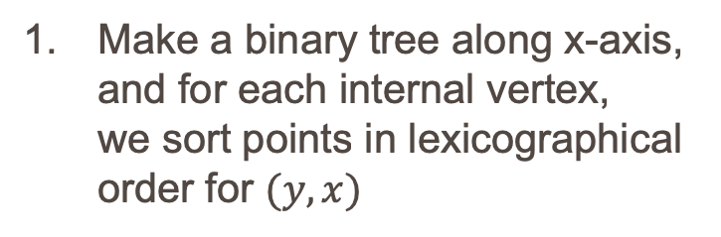
Fractional Cascading
Make a binary tree along x-axis, and for each internal vertex,
we sort points in lexicographical order for $(y,x)$
points
A
B
C
D
E
F
G
H
A
B
C
F
D
E
G
H
internal vertex
Notes:
Now, let's observe the procedure of finding points in the given rectangle.
We firstly make a binary tree along X-axis,
and for each internal vertex we sort points in lexicographical order for $(y,x)$
In the figure, the set of points is divided by green vertical line,
and the left-side set of points, denoted by green circle, are sorted in order of A, B, C and F
In the same manner, we make a binary tree for x-axis as follows.

Slide 22
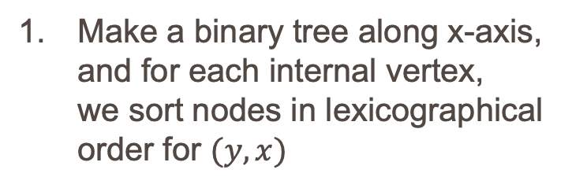
Fractional Cascading
Make a binary tree along x-axis, and for each internal vertex,
we sort nodes in lexicographical order for $(y,x)$
A
B
C
D
E
F
G
H
A
B
C
F
D
E
G
H
A
B
C
F
E
H
D
G
Notes:
Depth 2

Slide 23
Fractional Cascading
Make a binary tree along x-axis, and for each internal vertex,
we sort nodes in lexicographical order for $(y,x)$
A
B
C
D
E
F
G
H
A
B
C
F
D
E
G
H
A
B
C
F
E
H
D
G
B
A
C
F
E
H
D
G
Notes:
Depth 3

Slide 24
Fractional Cascading
Make a binary tree along x-axis, and for each internal vertex,
we sort nodes in lexicographical order for $(y,x)$
ymax
ymin
xmin
xmax
A
B
C
D
E
F
G
H
A
B
C
F
D
E
G
H
A
B
C
F
E
H
D
G
B
A
C
F
E
H
D
G
Notes:
Now, let’s search pints in the given rectangle.
I call the given rectangle the search area.

Slide 25
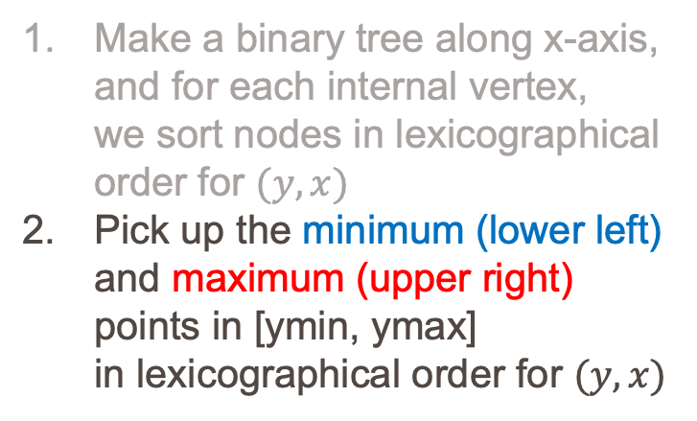
Fractional Cascading
Make a binary tree along x-axis, and for each internal vertex,
we sort nodes in lexicographical order for $(y,x)$
Pick up the minimum (lower left) and maximum (upper right) points in [ymin, ymax]
in lexicographical order for $(y,x)$
ymax
ymin
xmin
xmax
A
B
C
D
E
F
G
H
A
B
C
F
D
E
G
H
A
B
C
F
E
H
D
G
B
A
C
F
E
H
D
G
Notes:
First, among the points contained in the closed interval [ymin, ymax],
we pick up the lower left point, denoted by blue point, and upper right point, denoted by red point.
The corresponding array is shown in lower left figure

Slide 26
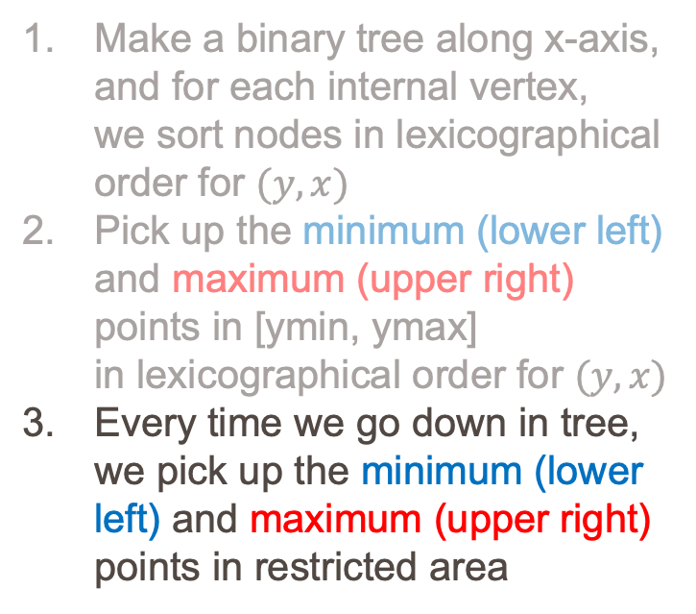
Fractional Cascading
Make a binary tree along x-axis, and for each internal vertex,
we sort nodes in lexicographical order for $(y,x)$
Pick up the minimum (lower left) and maximum (upper right) points in [ymin, ymax]
in lexicographical order for $(y,x)$
Every time we go down in tree, we pick up the minimum (lower left) and maximum (upper right) points in restricted area
ymax
restricted area
ymin
xmin
xmax
A
B
C
D
E
F
G
H
A
B
C
F
D
E
G
H
No Cost
A
B
C
F
E
H
D
G
B
A
C
F
E
H
D
G
Notes:
Going down to a child in tree means a restriction of search area with respect to x-axis,
At the every operation, we pick up the lower left and upper right point in restricted area
We must pay attention to that this operation (find D from B, and find G from F) can be done beforehand, and it is no computation cost.

Slide 27
Fractional Cascading
Make a binary tree along x-axis, and for each internal vertex,
we sort nodes in lexicographical order for $(y,x)$
Pick up the minimum (lower left) and maximum (upper right) points in [ymin, ymax]
in lexicographical order for $(y,x)$
Every time we go down in tree, we pick up the minimum (lower left) and maximum (upper right) points in restricted area
ymax
ymin
xmin
xmax
A
B
C
D
E
F
G
H
A
B
C
F
D
E
G
H
A
B
C
F
E
H
D
G
B
A
C
F
E
H
D
G
Notes:
Furthermore, we go down to the left vertex
In this case, both the lower left and upper right is same point $E$

Slide 28
Fractional Cascading
Out of the
search area
Make a binary tree along x-axis, and for each internal vertex,
we sort nodes in lexicographical order for $(y,x)$
Pick up the minimum (lower left) and maximum (upper right) points in [ymin, ymax]
in lexicographical order for $(y,x)$
Every time we go down in tree, we pick up the minimum (lower left) and maximum (upper right) points in restricted area
ymax
ymin
xmin
xmax
A
B
C
D
E
F
G
H
A
B
C
F
D
E
G
H
A
B
C
F
E
H
D
G
B
A
C
F
E
H
D
G
Notes:
On the other hand, we need not to go down to the right child
because the restricted area is out of the given rectangle.

Slide 29
Fractional Cascading
Make a binary tree along x-axis, and for each internal vertex,
we sort nodes in lexicographical order for $(y,x)$
Pick up the minimum (lower left) and maximum (upper right) points in [ymin, ymax]
in lexicographical order for $(y,x)$
Every time we go down in tree, we pick up the minimum (lower left) and maximum (upper right) points in restricted area
ymax
ymin
xmin
xmax
A
B
C
D
E
F
G
H
A
B
C
F
D
E
G
H
A
B
C
F
E
H
D
G
B
A
C
F
E
H
D
G
report
Notes:
We go down to the left-child, which is leaf, and report a point $E$

Slide 30
Fractional Cascading
Make a binary tree along x-axis, and for each internal vertex,
we sort nodes in lexicographical order for $(y,x)$
Pick up the minimum (lower left) and maximum (upper right) points in [ymin, ymax]
in lexicographical order for $(y,x)$
Every time we go down in tree, we pick up the minimum (lower left) and maximum (upper right) points in restricted area
ymax
ymin
xmin
xmax
A
B
C
D
E
F
G
H
A
B
C
F
D
E
G
H
A
B
C
F
E
H
D
G
B
A
C
F
E
H
D
G
Notes:
If we try to go down to the right-child, we cannot find upper-right point.
Hence, we cannot report H.

Slide 31
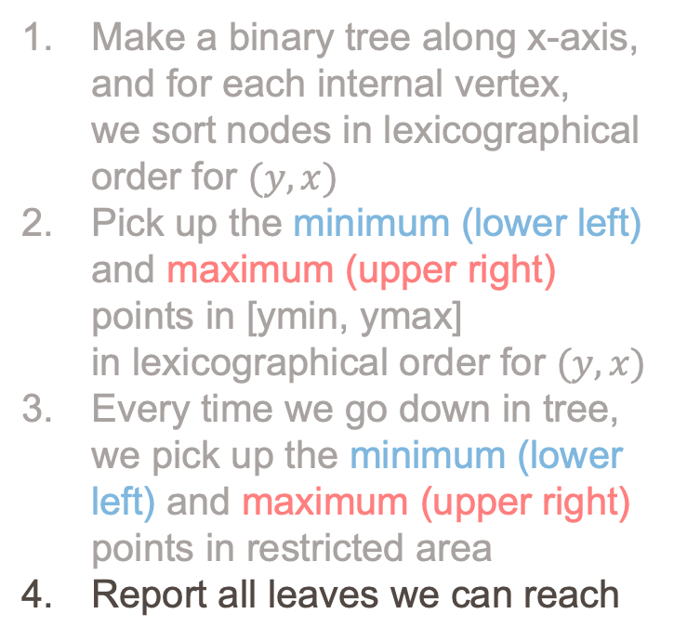
Fractional Cascading
Make a binary tree along x-axis, and for each internal vertex,
we sort nodes in lexicographical order for $(y,x)$
Pick up the minimum (lower left) and maximum (upper right) points in [ymin, ymax]
in lexicographical order for $(y,x)$
Every time we go down in tree, we pick up the minimum (lower left) and maximum (upper right) points in restricted area
Report all leaves we can reach
ymax
ymin
xmin
xmax
A
B
C
D
E
F
G
H
A
B
C
F
D
E
G
H
A
B
C
F
E
H
D
G
B
A
C
F
E
H
D
G
Notes:
Finally, the data structure reports all leaves we can reach.
In our example, 4 points B, C, F, and E are reported.

Slide 32
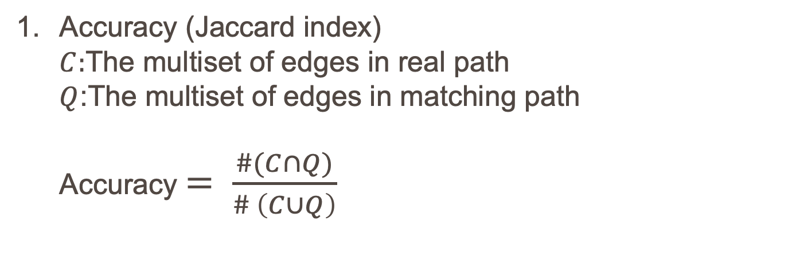

Evaluation Indices
Accuracy (Jaccard index)
$C:$The multiset of edges in real path
$Q$:The multiset of edges in matching path
Accuracy $= \frac{\#(C∩Q)}{\# \left(C∪Q\right)}$
(Ex)
Accuracy=$\frac{3}{4}$
Real
Matching
Speed
The number of GPS data matched by an algorithm per second (we calculate the speed by using GPS data of many vehicles)
Notes:
(ここから5分を見積もる)
Now we evaluate our algorithm in terms of accuracy and speed.
We select the Jaccard index as the index of accuracy.
Concretely, the accuracy is defined as the intersection of multisets of edges in real and matching path over the union of ones.
For example, the accuracy of the figure is three over four.
As for processing speed, we use the number of GPS data matched by an algorithm per second.

Slide 33
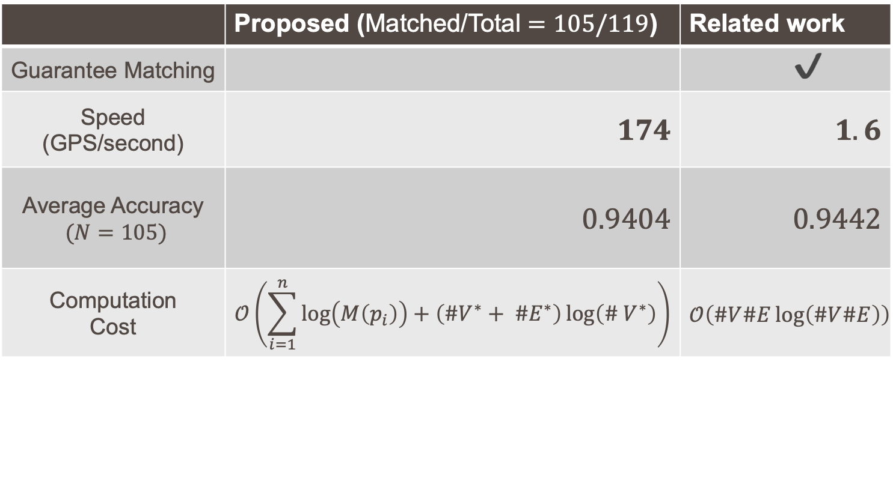
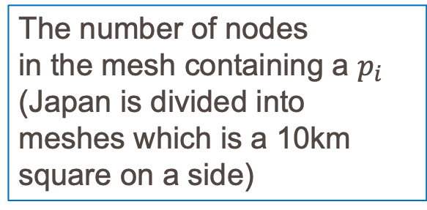
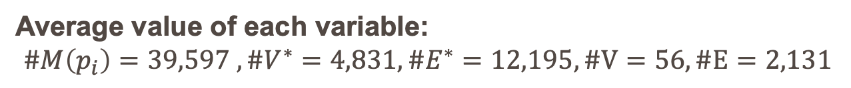


Experiment
We propose fast map-matching algorithm keeping in high accuracy
 | Proposed (Matched/Total $=105/119$) | Related work
Guarantee Matching |  | ✔️
Speed (GPS/second) | $174$ | $1.6$
Average Accuracy $(N=105)$ | $0.9404$ | $0.9442$
Computation Cost | $$𝒪\left(\sum_{i=1}^{n}{\log\left(M\left(p_{i}\right)\right)}+\left(\#V^{∗}+ \#E^{∗}\right)\log\left(\# V^{∗}\right)\right)$$ | $$𝒪\left(\#V\#E\log\left(\#V\#E\right)\right)$$
The number of nodes
in the mesh containing a $p_{i}$ (Japan is divided into meshes which is a 10km square on a side)
$$≫$$
$$≈$$
Average value of each variable:
$$\#M\left(p_{i}\right)=39,597 ,\#V^{∗}=4,831, \#E^{∗}=12,195, \#V=56,\#E=2,131$$
Platform:
CPU: Intel(R) Xeon(R) CPU E5-2699 v3 @ 2.3GHz x 2, RAM:512GB
Notes:
Here is the comparison between proposed and related work algorithm.
We apply these algorithms to real $119$ GPS trajectory data
As mentioned beforehand, our algorithm sometimes fails to obtain a path because of disconnection of layers.
In this experiment, we succeed in obtaining paths for $105$ GPS trajectories and fail for $14$ ones.
Therefore we compare our algorithm with previous one for the matched $105$ GPS trajectory.
As you can see, our algorithm is much faster than the previous one with much the same accuracy.

Slide 34
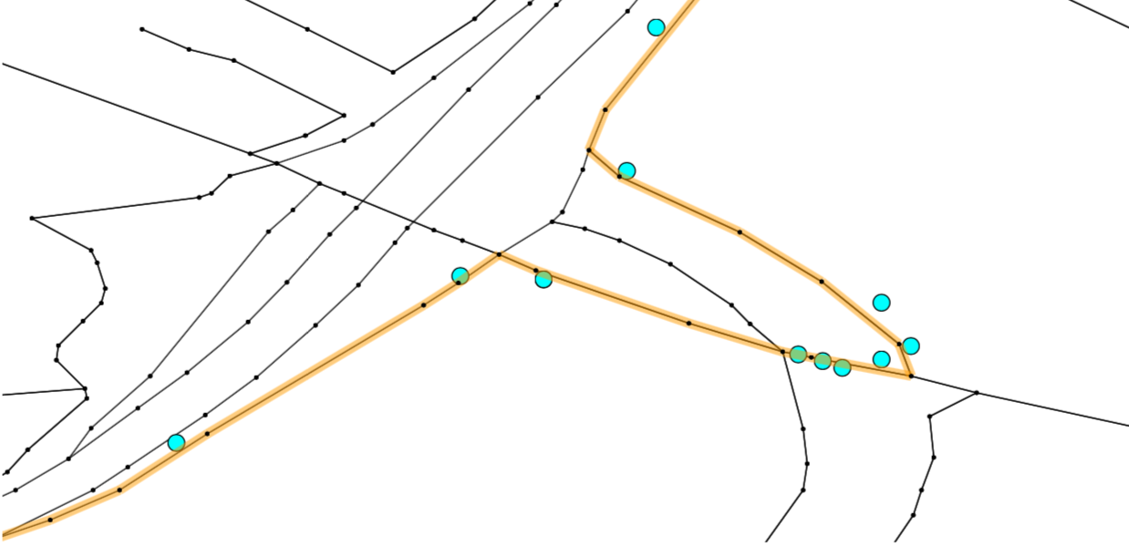
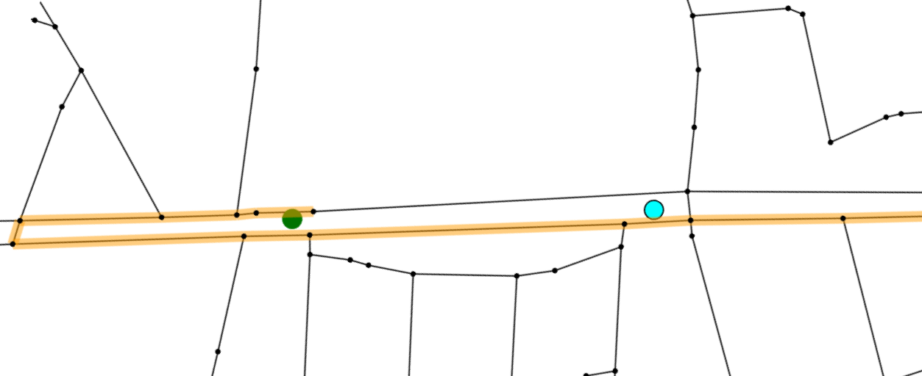
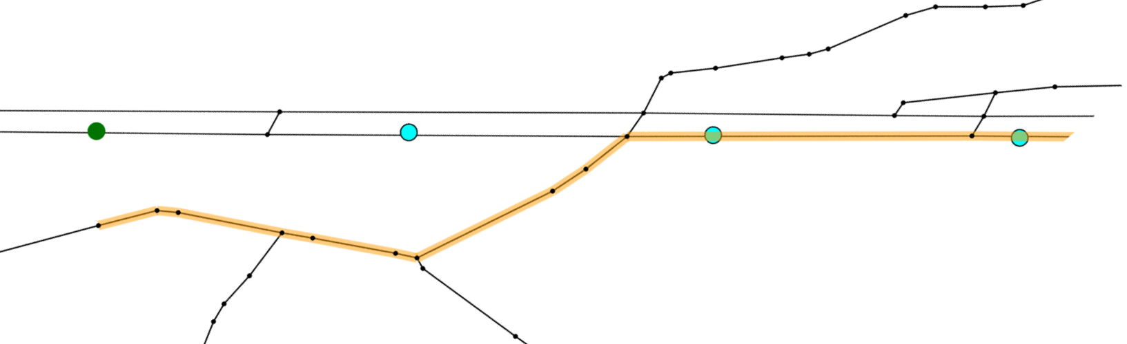
Matching Results
Proposed
Related
Good
First GPS
Bad
The error of the first GPS
is large
First GPS is far from
any nodes
Notes:
I also present the matching paths of both proposed and related-work algorithms, and observe the weak points of each algorithm.
Proposed algorithm tends to fail matching if the error of first or last GPS is large.
This is because we connects source or sink to the nearest node of each connected component, and the node is sometimes not included in real path.
However we can handle it by adding a minor operation, perhaps.
On the other hand, related work tends to cause mismatching if the first and last GPS is far from any nodes, shown in lower right figure.

Slide 35
Summary
We propose the global map-matching based on the time-expanded graph
Our algorithm is more than 100x faster than the algorithm based on Fréchet distance while keeping much the same accuracy
We should determine the appropriate size of neighborhood in our model
Notes:
As a conclusion, I would like to summarize the major points.
We propose a global map-matching based on the time-expanded graph
Our algorithm is well balanced with respect to accuracy and speed
We should determine the appropriate size of neighborhood in our model.
That’s all for my presentation
Thank you for your attention

Slide 36
Reference
[1] HELMUT ALT and MICHAEL GODAU.COMPUTING THE FRE ́CHET DISTANCE BETWEEN TWO POLYGONAL CURVES. International Journal of Computational Geometry & Applications
[2] Matching planar maps. Helmut Alt, Alon Efrat, Gu ̈nter Rote, and Carola Wenk. Journal of Algorithms (2003)
[3] Fractional Cascading: I. A Data Structuring Technique. Bernard Chazelle and Leonidas J and Guibas. Algorithmica (1986)
[4] On Map-Matching Vehicle Tracking Data. Sotiris Brakatsoulas, Dieter Pfoser, Randall Salas, Carola Wenk. th 31st international conference on Very large data bases (2005) 853- 864.
[5] Current map-matching algorithms for transport applications: State-of-the art and future research directions. Mohammed A. Quddus, Washington Y. Ochieng, Robert B. Noland. Transportation Research Part C: Emerging Technologies Vol 15. 312-328(2007). DOI: 10.1016/j.trc.2007.05.002

